Slide 1
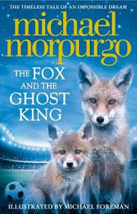
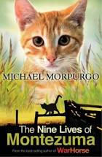
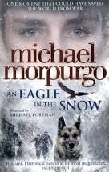
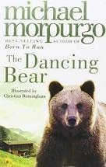
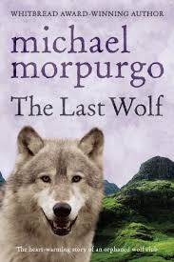
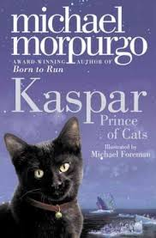
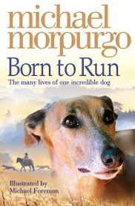
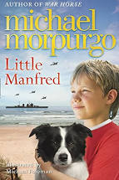
Michael Morpurgo
By hH

Slide 2
Facts about Michael Morpurgo
Did you know that Michael Morpurgo was born on the 5th of October 1943 in St Albans ,Hertfordshire?
He has written over 120 books!
After graduating from university , Michael became a primary school teacher in Kent.
He writes all his books in exercise books.
His favourite animal is an Elephant!
In 1974 his first book was published ,which was It Never Rained.

Slide 3
Michael Morpurgo`s best seller
War Horse (the best seller) has been made into lots of things like movies , West End shows and much more . War Horse is about a horse called Joey and his life. It was made from the point of view of Joey the horse so he tells you about how he is feeling and what he his thinking about . For me it was a heart warming story but every now and then there was a heart breaking moments like when Joey was taken away from Albert, his old rider to go to the war !

Slide 4
FUN FACTS ABOUT MICHAEL MORPURGO
He set up ” farms for city children” charity with his wife Clare in 1976 after leaving his job as a teacher that he held for ten years.
About 85,000 children have taken part in the Farms for City Children scheme since it was set up, and the charity now has three farms in Devon, Gloucestershire and Wales
Both Michael and his wife were awarded an MBE for services to youth in 1999 and in 2006, Michael also received an OBE from the Queen.
Michael Morpurgo`s 100th book, Private Peaceful, was first published in 2003 and was adapted into a play in 2004 which was later revived in 2014.
Many of Michael Morpurgo’s books have been adapted. Film versions have been made of Friend or Foe, Private Peaceful, and Why the Whales Came – which was also adapted to a stage play. My Friend Walter, Purple Penguins and Out of the Ashes were also adapted for TV. War Horse, one of Michael’s best selling novels, has been adapted as a radio broadcast and stage play.

Slide 5
SHADOW BY MICHAEL MORPURGO
I am currently reading Shadow, it is a very interesting book and I am really enjoying it! The story is about a boy called Aman who has never needed a friend more then a springer spaniel appears in the mouth of his Afghan cave . The dog becomes a constant companion , a Shadow, and that`s what Aman decides to call her!

Slide 6
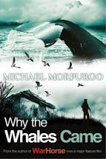
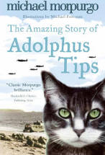
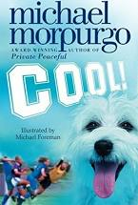
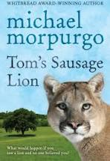
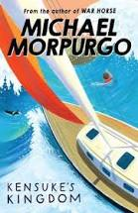
THE TOP TWELVE MOST POPULAR BOOKS
War Horse
Private Peaceful
The Amazing Story of Adolphus Tips
Cool!
Out of the Ashes
Kensuke’s Kingdom
The Butterfly Lion
The Wreck of the Zanzibar
Tom’s Sausage Lion
Why the Whales Came
Not Bad for a Bad Lad

Slide 7
Thank you for reading my presentation on michael morpurgo!
I hope it inspires you to read one of his fabulous books!!
By HH

